Slide 1

LANE DETECTION SYSTEM FOR SELF-DRIVING VEHICLE

Slide 2
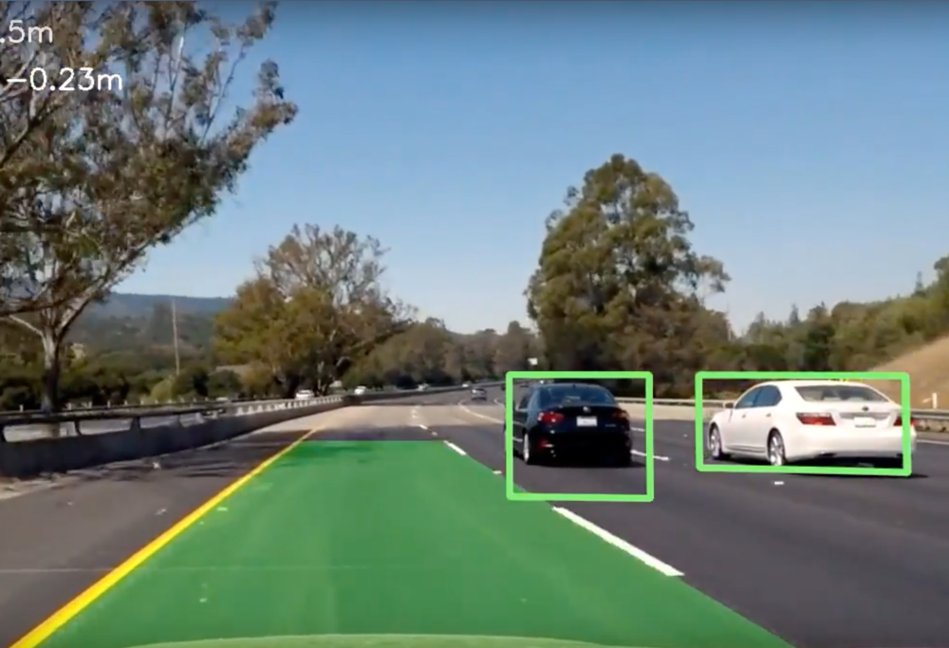
Abstract
The Lane Detection System (LDS) is an extremely complex and sophisticated technological framework that leverages the power of AI and Canny Edge Detection (CED) to enable the prompt identification and tracking of lanes on a road. The system utilizes a highly advanced neural network architecture, which has been pre-trained on a vast and diverse dataset of road images. This enables it to detect and categorize a wide range of lane markings, including dashed and solid lines, with exceptional precision and accuracy, even under challenging and variable weather and lighting conditions. In addition to the Canny Edge Detection algorithm, the system employs various other advanced image processing techniques, such as morphological operations and Hough transforms, to further refine the lane boundaries and eliminate any erroneous detections or noise. This results in an accurate and clear visual representation of the lane markings and their positions in relation to the vehicle. This is a highly effective solution for real-time lane detection in a wide range of driving scenarios, and its unparalleled robustness and accuracy make it an essential tool for enhancing road safety and improving driver assistance systems.

Slide 3
LITERATURE SURVEY

Slide 4
S.No | Title | Author Name and Year of Publication | Methodology | Inference | Drawbacks
1. | Analysis of lane detection techniques using openCV | Sunil Kumar Vishwakarma; Akash; Divakar Singh Yadav(IEEE 2015) | Camera mounted in front of the vehicle. On the basis of the Receiver Operating Characteristic (ROC) curve and Detection Error Tradeoff (DET) curve performance of these lanes, detection techniques have been measured. | After analyzing the performances of both the methods it is verified that method 1 (green curve) based on Canny edge detection is better than Sobel operator-based lane detection method 2 (blue curve) as it covers a greater area. | Cannot be applied on unstructured roads. Or roads without markings.
2. | Real-time lane detection for autonomous vehicles | Huimin Tan et al 2017 | This paper proposes a real-time lane detection method based on computer vision techniques. They use color segmentation, edge detection, and Hough transform to detect lane markings in a video stream. | Overall, the paper provides a good overview of the state-of-the-art techniques for lane detection in autonomous vehicles, and the proposed method can be used as a starting point for developing more advanced lane detection systems | Limited applicability to different road types,Sensitivity to lighting and weather conditions,Dependence on camera calibration,Limited validation on large-scale datasets

Slide 5
3. | Deep neural networks for lane detection: An empirical comparison | Giuseppe Amato et al 2018 | This paper compares different deep learning-based approaches to lane detection. They evaluate the performance of several state-of-the-art neural networks on a large dataset of road images. | The paper provides a valuable comparison of different deep learning-based approaches to lane detection and highlights the importance of network architecture and training techniques in achieving high accuracy. The findings can be used to guide the design of more effective deep learning-based lane detection systems. | One disadvantage of the paper is that it only compares deep learning-based approaches and does not consider traditional computer vision-based methods for lane detection. While deep learning-based methods have shown promising results for lane detection, they can be computationally expensive and require a large amount of training data. Traditional computer vision-based methods, on the other hand, can be more efficient and require less data.
4. | Lane detection and tracking using B-spline curve fitting | M. Nasr et al 2015 | This paper proposes a lane detection and tracking algorithm based on B-spline curve fitting. They use a sliding window approach to detect the lane markings and track them over time using a Kalman filter. | The paper presents experimental results on a dataset of challenging road scenarios and shows that the proposed lane detection and tracking algorithm achieves high accuracy and robustness compared to other state-of-the-art lane detection methods. | One potential disadvantage of this approach is that it may not work well in situations where the lane markings are discontinuous or broken, as it relies on identifying a continuous set of candidate points within a sliding window. In addition, this method may be computationally expensive, as fitting a B-spline curve requires solving a system of linear equations, which can be time-consuming for large datasets or real-time applications.

Slide 6
Existing Methods with their Demerits
Color-based Detection
Sensitivity to Lighting Conditions: Color-based detection can be sensitive to changes in lighting conditions. For example, if the lighting conditions change, the colors of the lane markings may appear differently, leading to incorrect detection or false positives.
Vulnerability to Road Debris: Color-based detection can also be affected by road debris or dirt on the road surface, which can obscure or alter the color of the lane markings. This can lead to incorrect detection or false positives.
Limited Applicability: Color-based detection is not suitable for all road environments. It may be less effective on roads with multiple lanes or complex road markings, as the algorithm may struggle to differentiate between different lane markings. Computational Complexity: Color-based detection can be computationally intensive, as it requires analyzing the color and intensity of every pixel in the input image. This can result in slower processing times and may be less suitable for real-time applications.
Sobel Edge Detection
Sensitivity to Noise: Sobel edge detection is susceptible to noise in the input image. Even minor noise in the image can result in false positives or false negatives, leading to inaccurate lane detection.
Difficulty in Detecting Curved Lanes: Sobel edge detection is more suitable for detecting straight edges, and it may not be as effective in detecting curved lane markings. This can lead to incorrect lane boundary detection or incorrect lane markings classification.
Not Invariant to Rotation: Sobel edge detection is not invariant to rotation, meaning that if the input image is rotated, the detected edges will also be rotated, which can lead to incorrect lane detection. Difficulty in Handling Shadows: Sobel edge detection may struggle to handle shadows, especially when they are cast on the lane markings. This can result in incorrect detection or false positives.

Slide 7
Challenges to Address
Variable lighting conditions
01
Occlusion
02
Complex road layouts
03
Different types of road surfaces
04
Vehicle speed
05
Changes in lighting conditions can affect the visibility of lane markings. The system must adapt to lighting conditions, such as bright sunlight, shadows, and inclement weather.
Other vehicles, objects, or road constructions may block the view of the lane markings. The system must detect and track the lanes even when partially occluded.
Challenges to Address
Some road layouts, such as intersections and roundabouts, have complex lane markings that may confuse the system. The system needs to recognize and differentiate between different types of lane markings.
Lane markings may appear differently on different types of road surfaces, such as concrete, asphalt, or gravel. The system needs to be able to detect lane markings accurately on different types of road surfaces.
At high speeds, lane markings may appear blurred or distorted, making it difficult for the system to detect and track them accurately. The system needs to adapt to different vehicle speeds.

Slide 8
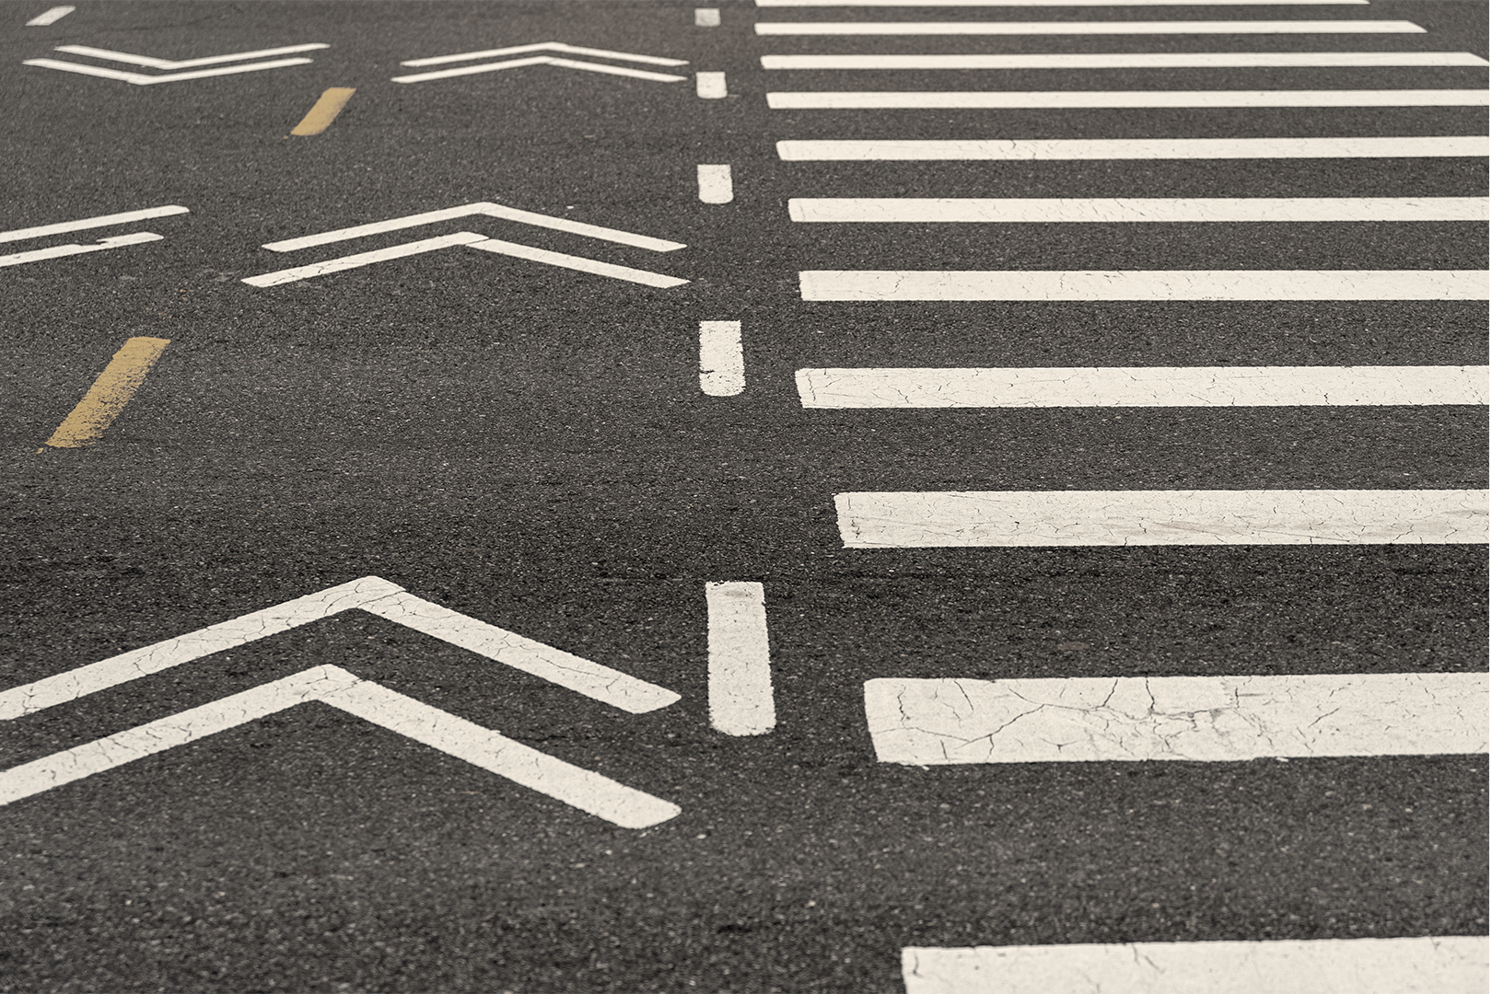
Objectives
Low error rate: Canny edge detection has a low error rate, meaning it can accurately detect edges in an image while minimizing the number of false positives and false negatives.
Accurate edge localization: Canny edge detection is able to accurately localize edges in an image, which means it can identify the exact position of the edges with high precision.
Single-edge response: Canny edge detection ensures that each edge in an image is only detected once, preventing multiple detections of the same edge.
Robustness to noise: Canny edge detection is robust to noise in an image, meaning it can effectively detect edges even in noisy images without producing many false positives.

Slide 9
Ability to detect edges of varying widths: Canny edge detection can detect edges of varying widths, making it useful for a wide range of applications.
Easy to implement: Canny edge detection is relatively easy to implement and can be applied to a variety of image processing tasks.

Slide 10
HOW IS OUR MODEL DIFFERENT FROM OTHER MODELS

Slide 11
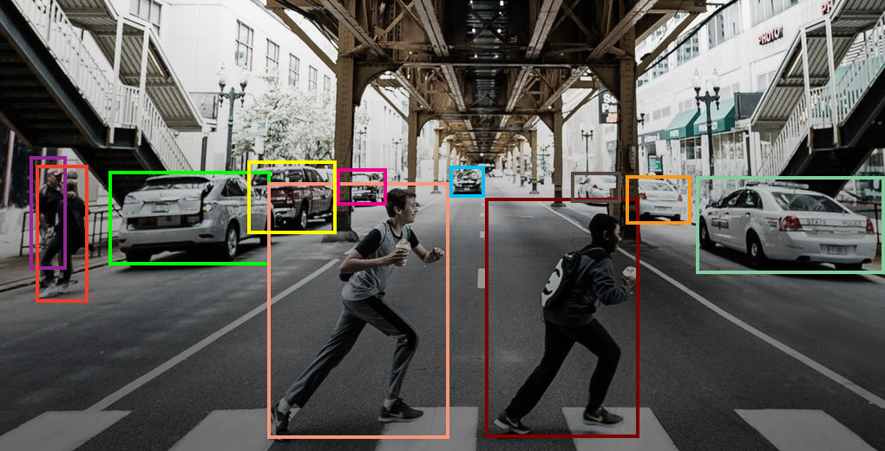
The problem of detecting lanes on roads where lane markings are absent is a major challenge for autonomous driving systems. In such cases, the existing models in the market may not be able to provide reliable lane detection, which can lead to potentially dangerous situations.
To overcome this challenge, our models utilize computer vision techniques to detect various objects in front of the vehicle. These objects can include other vehicles, pedestrians, obstacles, or any other objects that might be present on the road. By analyzing the position and motion of these objects, our models can determine whether they represent a credible obstruction for the vehicle.
Based on this analysis, our models can adjust the vehicle's trajectory by changing lanes or passing by the obstacle. This capability allows our models to create an imaginary lane when there are no physical markings available. By utilizing the detected objects as virtual edges, our models can create a perception of a safe passage for the vehicle.
In essence, our models use a combination of object detection and trajectory planning to navigate through roads where lane markings are absent. This approach allows our models to adapt to a wide range of road conditions and environments, making them more robust and reliable in real-world driving scenarios.

Slide 12
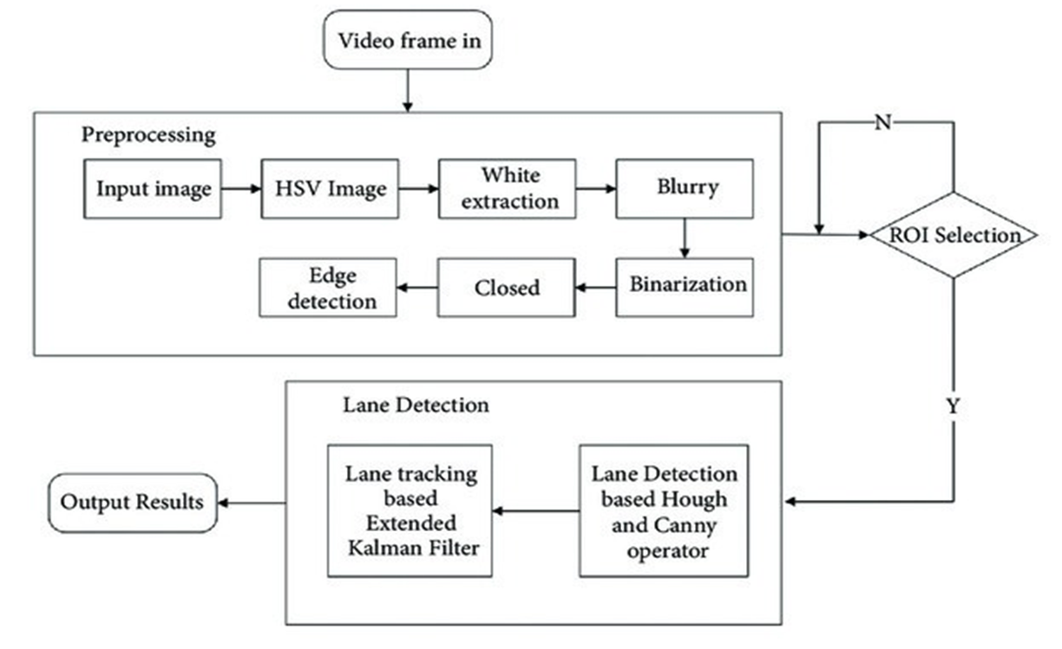
Architecture Diagram

Slide 13
Modules Description and Implementation
Lane detection is a computer vision task that involves identifying and tracking the lane markings on a road. Here are some of the common modules in lane detection:
Image Acquisition: This module is responsible for capturing images or videos of the road ahead from a camera mounted on the vehicle.
Preprocessing: This module involves several image processing techniques to enhance the image quality, such as grayscale conversion, noise reduction, and contrast enhancement.
Edge Detection: This module identifies the edges in the image using techniques like Canny edge detection or Sobel operator.
Region of Interest Selection: This module identifies the region in the image where the lanes are most likely to be present, based on the location of the camera and the perspective of the road.
Hough Transform: This module converts the edge points in the image into line segments using the Hough Transform.

Slide 14
Lane Line Fitting: This module fits a mathematical model to the detected lane line segments using techniques like linear regression or polynomial fitting.
Lane Line Tracking: This module tracks the lane lines over multiple frames to improve the robustness and accuracy of the lane detection algorithm.
Visualization: This module overlays the detected lane lines on the original image or video to provide visual feedback to the driver.

Slide 15
References
Cho, Jae-Hyun, Young-Min Jang, and Sang-Bock Cho. "Lane recognition algorithm using the Hough transform with applied accumulator cells in multichannel ROI." In Consumer Electronics (ISCE 2014), The 18th IEEE International Symposium on, pp. 1- 3. IEEE, 2014.
Low, Chan Yee, HairiZamzuri, and SaifulAmriMazlan. "Simple Robust Road Lane Detection Algorithm”. IEEE, 2014.
Ding, Dajun, Chanho Lee, and Kwang- Lee. "An adaptive road ROI determination algorithm for lane detection." In TENCON 2013-2013 IEEE Region 10 Conference (31194), pp. 1-4. IEEE, 2013.
Fani, Hongli, and Weihua Wang. "Edge Detection of Color Road Image Based on Lab Model." In Computational and Information Sciences (ICCIS), 2013 Fifth International Conference on, pp. 298- 301. IEEE, 2013.
Nalla, Phaneendra, GCL AbhiramanGoud, and V. Padmaja. "ACCIDENT AVOIDING SYSTEM USING LANE DETECTION." IJRECE 1, no. 1 (2013): 01-04.

Slide 16

THANK YOU

